Slide 1



School of Information Technology
333 Sen. Gil Puyat Ave., Makati City 1200, Philippines
A Computer Vision Approach to Ambulance Classification in the Philippines using YOLOv5 Small
STEVE VINCENT PHILLIP C. FERIA
JOSE RAFAEL A. FRANCO
HANS C. LAGUNA
Notes:
Good day to all, the title of my presentation is:
A Computer Vision Approach to Ambulance Classification in the Philippines using YOLOv5 Small
I’m Paul Tomas from Mapua Univ. Philippines.

Slide 2
Presentation Sequence
Introduction
Objectives
Conceptual Framework
Methodology
Results and Discussion
Conclusion and Recommendations
References
Notes:
These are the following agendas that will be tackled through out this presentation.
Will start with the discussion of the introduction, objectives, conceptual framework, methodology, results and discussion, conclusion and recommendations, and last the references that are used in the study.

Slide 3

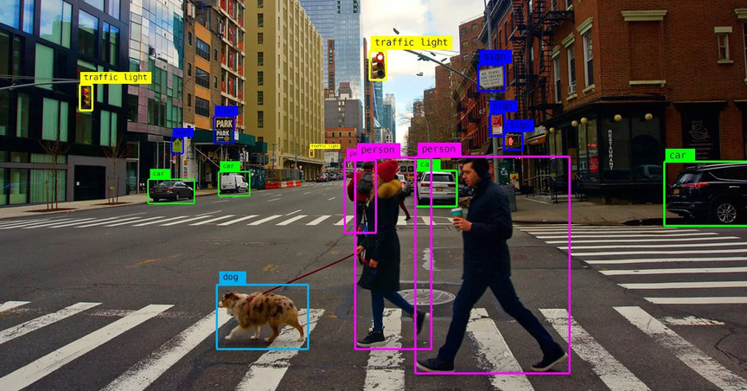

Introduction
Computer Vision
Objectives
Conceptual Framework
Methodology
A field of artificial intelligence for understanding visual features of the world.
Big part of it is object detection that is applied through images and video
Results and Discussion
Conclusion and Recommendations
References
A Computer Vision Approach to Ambulance Classification in the Philippines using YOLOv5 Small
Notes:
Starting off with the introduction. Computer vision has various uses such as image classification, object detection, and tracking.
All of which makes the computers understand the visual aspects of a real-world scenario.

Slide 4

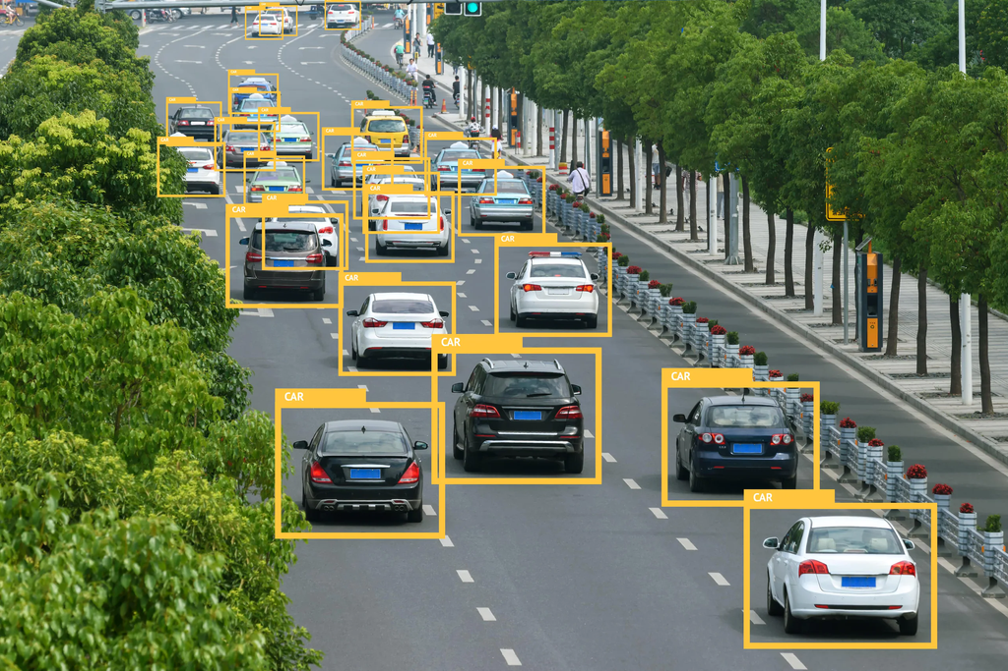
Introduction
Machine Learning
Objectives
Object Detection Algorithms: Machine learning vehicle detection relies on algorithms like YOLO and Faster R-CNN to identify and locate vehicles within images or video frames.
Data Annotation and Training: Annotated datasets are crucial for training vehicle detection models, teaching them to recognize vehicles and their positions.
Applications and Benefits: Machine learning vehicle detection is used in autonomous driving, traffic management, and surveillance to enhance safety, efficiency, and automation.
Conceptual Framework
Methodology
Results and Discussion
Conclusion and Recommendations
References
A Computer Vision Approach to Ambulance Classification in the Philippines using YOLOv5 Small
Notes:
A big part of the study is machine learning in vehicle detection. Machine learning is widely used in vehicle detection systems to automatically identify and track vehicles in real-time. The primary approach for vehicle detection is object detection, which is the process of locating and identifying objects of interest within an image or video.
The three bullet describes how machine learning takes place within the detection matter.

Slide 5
Introduction
Main Objective
Improve the YOLOv5s model for identifying different types and classes of ambulances and create localized dataset for Philippine Ambulances
Objectives
Conceptual Framework
1. Assess the performance metrics of the YOLOv5 model, specifically in the small weight, in detecting and classifying Philippines ambulances and their key features
Methodology
2. To assess the dissimilarity between clean and augmented images using SSIM in order to determine the average Structural Similarity Index (SSIM) score, which would reflect the diversity and non-redundancy attained in the dataset.
Results and Discussion
Conclusion and Recommendations
3. To identify the right set hyperparameters through hyperparameter tuning in order to maximize the performance of the YOLOv5 small model.
References
A Computer Vision Approach to Ambulance Classification in the Philippines using YOLOv5 Small
Notes:
This next slide presents the main objective of the study that are specified into three.
The first one is to Assess the performance metrics of the YOLOv5 model, specifically in the small weight, in detecting and classifying Philippines ambulances and their key features
Second, To assess the dissimilarity between clean and augmented images using SSIM in order to determine the average Structural Similarity Index (SSIM) score, which would reflect the diversity and non-redundancy attained in the dataset.
Third is to identify the right set hyperparameters through hyperparameter tuning in order to maximize the performance of the YOLOv5 small model.

Slide 6
Introduction
The Aforementioned Objectives Seek to Answer the Following Research Questions:
Objectives
Conceptual Framework
Is the YOLOv5s model able to attain high performance metrics in detecting and classifying different types of Philippine ambulances and its features?
By using the Structural Similarity Index (SSIM) to evaluate the dissimilarity between clean and augmented images, what is the average SSIM score, on a scale from 0 to 1, indicating the degree of diversity and non-redundancy achieved in the dataset?
By applying hyperparameter tuning, what is the optimal set of hyperparameters that should be used to maximize the performance of the YOLOv5s model?
Methodology
Results and Discussion
Conclusion and Recommendations
References
A Computer Vision Approach to Ambulance Classification in the Philippines using YOLOv5 Small
Notes:
To give the study a sense of direction, these are the set of questions created that will serve as a guide throughout.
First, Is the YOLOv5s model able to attain high performance metrics in detecting and classifying different types of Philippine ambulances and its features?
Second, By using the Structural Similarity Index (SSIM) to evaluate the dissimilarity between clean and augmented images, what is the average SSIM score, on a scale from 0 to 1, indicating the degree of diversity and non-redundancy achieved in the dataset?
Third, By applying hyperparameter tuning, what is the optimal set of hyperparameters that should be used to maximize the performance of the YOLOv5s model?

Slide 7
Introduction
Scope and Limitations
Objectives
Conceptual Framework
The study focuses on ambulance detection in the Philippines using YOLOv5s, a locally collected dataset, and three types of Philippine ambulances.
Images of Philippine ambulances from the internet are used, but limitations include daytime-only captures and a lack of specific angles or setups.
YOLOv5s is the primary model with hyperparameter tuning and six augmentation techniques, but the study does not extend to real-time implementation or other
The study's scope is limited to the Philippines, daytime images, and ambulance detection; generalizability to other regions and conditions may be limited.
Methodology
Results and Discussion
Conclusion and Recommendations
References
A Computer Vision Approach to Ambulance Classification in the Philippines using YOLOv5 Small
Notes:
This will be the cover of the said study.
The study focuses on ambulance detection in the Philippines using YOLOv5s, a locally collected dataset, and three types of Philippine ambulances.
Images of Philippine ambulances from the internet are used, but limitations include daytime-only captures and a lack of specific angles or setups.
YOLOv5s is the primary model with hyperparameter tuning and six augmentation techniques, but the study does not extend to real-time implementation or other
The study's scope is limited to the Philippines, daytime images, and ambulance detection; generalizability to other regions and conditions may be limited.

Slide 8
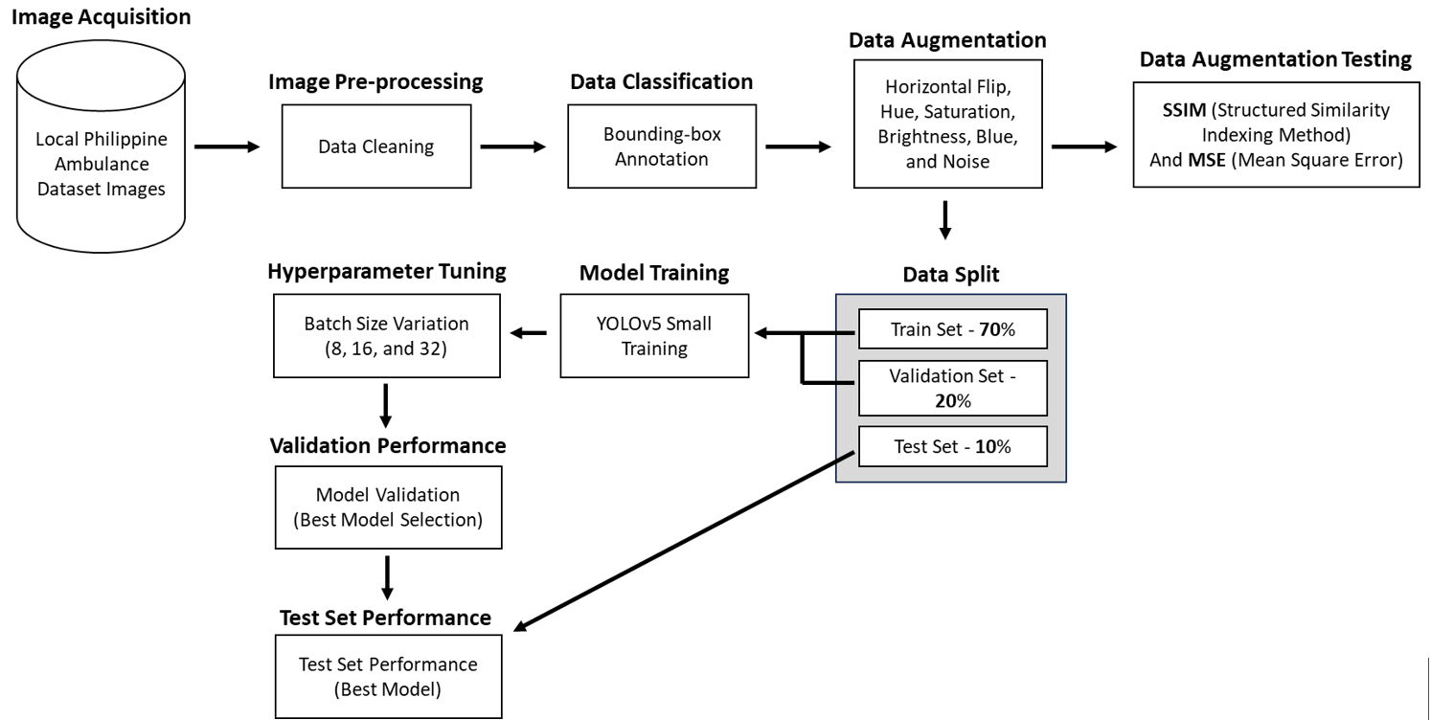
Introduction
Objectives
Conceptual Framework
Methodology
Results and Discussion
Conclusion and Recommendations
References
A Computer Vision Approach to Ambulance Classification in the Philippines using YOLOv5 Small
Notes:
As for the conceptual framework of this study, it focuses around the creation of a YOLOv5-based model designed for the detection of ambulances in the specific context of the Philippines. The researchers compiled a dataset comprising localized images of Philippine ambulances to train the YOLOv5 small model. This dataset is subsequently used for validation and testing phases. The figure illustrates the approach for developing this ambulance detection model.
The conceptual framework encompasses several key stages, including data acquisition, image preprocessing, data classification, data augmentation, data augmentation testing, model training, hyperparameter tuning, validation, and performance testing. The primary goal of our proposed conceptual framework is to enhance the practicality of ambulance detection by utilizing computer vision techniques.

Slide 9
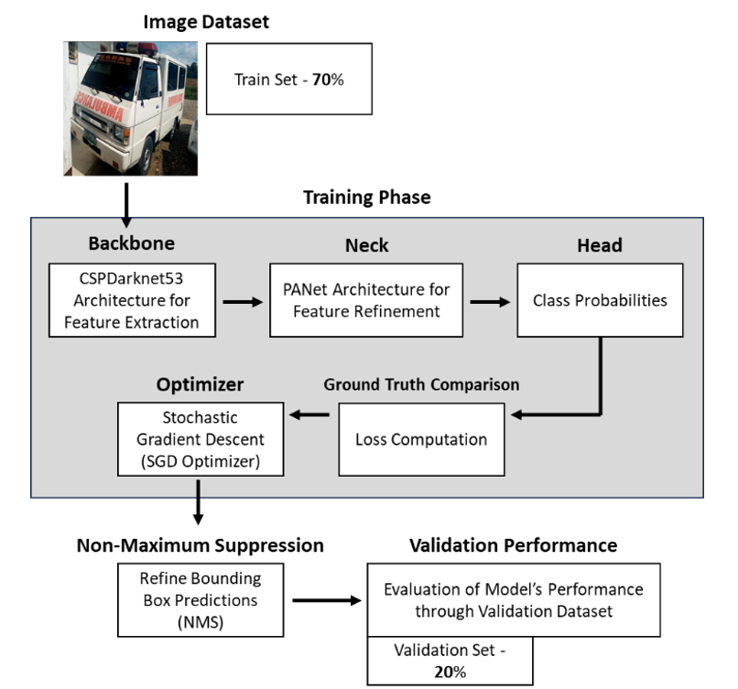
Introduction
Objectives
Conceptual Framework
Methodology
Results and Discussion
Conclusion and Recommendations
References
A Computer Vision Approach to Ambulance Classification in the Philippines using YOLOv5 Small
Notes:
YOLOv5s is a powerful model for real-time object recognition, featuring CSPDarknet53, PANet, and efficient techniques. It uses Stochastic Gradient Descent (SGD) optimization and Non-Maximum Suppression (NMS) to ensure high precision and efficiency. In this context, it's applied to ambulance detection, reshaping object detection. The figure illustrates the training process.
First, CSPDarknet53 extracts initial features from the ambulance image training set.
Next, PANet refines and integrates features for a better understanding of spatial relationships in images.
Next, the Detection Head interprets features to identify ambulances, classify types, and recognize specific features.
Once the dataset has passed through the backbone, neck and head, the Ground truth comparison and loss computation assess model predictions.
SGD optimization fine-tunes the model with specified settings like learning rate, momentum, and weight decay (e.g., learning rate: 0.001, momentum: 0.9, weight decay: 1e-5).
Lastly, NMS refines predicted bounding boxes, optimizing precision and eliminating duplicates.

Slide 10
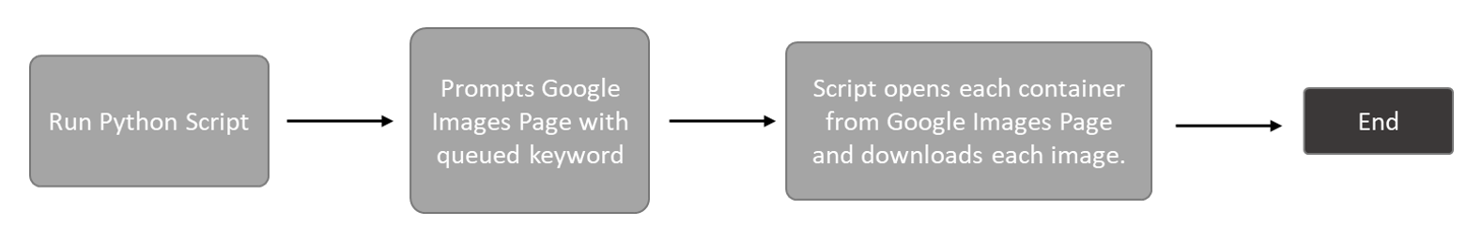
Introduction
Data Acquisition
Objectives
Used custom Python script with Selenium and Google Chrome
Searched for "Philippine Ambulances" on Google Images
Script scrolled down to load image containers and downloaded images
Collected 1840 clean images of Philippine ambulances
Expanded to 5520 after data augmentation
Conceptual Framework
Methodology
Results and Discussion
Conclusion and Recommendations
References
A Computer Vision Approach to Ambulance Classification in the Philippines using YOLOv5 Small
Notes:
The image acquisition phase was a systematic process involving web scraping to create an extensive dataset of local ambulance images. To achieve this, a custom Python script was developed, which utilized the Selenium web automation library in conjunction with Google Chrome. The script initiated a search for "Philippine Ambulance" on Google Images and systematically scrolled down to load image containers. It then automatically opened and downloaded images from each container, resulting in a diverse and representative dataset. In total, the researchers collected 1,840 clean images of Philippine ambulances, which later expanded to 5,520 after data augmentation.

Slide 11
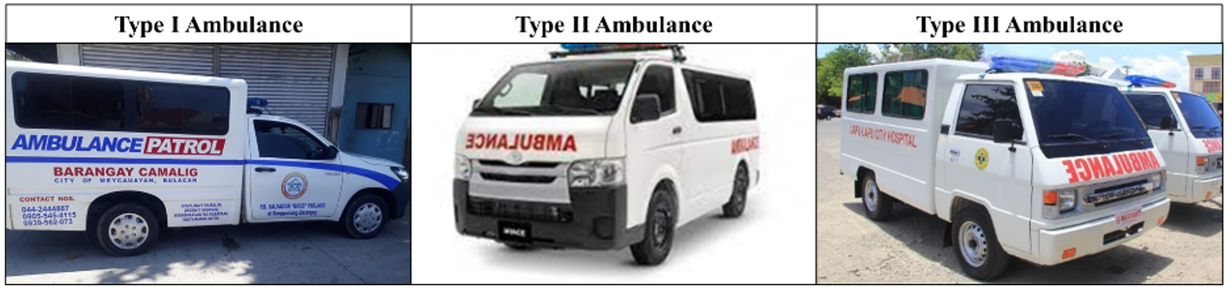
Introduction
Dataset Overview
Objectives
Dataset includes Philippine Type I, Type II, and Type III ambulances
Distinctive features were classified: Sirens and Labels
Ambulance Classification:
Type I: Small truck-based, box-shaped patient compartment
Type II: Heavy-duty van units, minimal modification
Type III: Similar to Type I, box compartment on heavy-duty van chassis
Conceptual Framework
Methodology
Results and Discussion
Conclusion and Recommendations
References
A Computer Vision Approach to Ambulance Classification in the Philippines using YOLOv5 Small
Notes:
The dataset primarily includes exclusively Philippine ambulances, specifically of Type I, Type II, and Type III. These ambulances are commonly equipped with distinctive sirens and labeled as "Ambulance." Figure 2 visually illustrates the different classifications of these ambulances.
Type I ambulances are essentially vehicles constructed from small trucks. They have a box-shaped patient compartment mounted onto the truck's chassis, often derived from pickup trucks and light-duty trucks. Type I ambulances typically provide Basic Life Support (BLS).
Type II ambulances are mainly crafted from heavy-duty van units, with minimal modification except for the addition of standard ambulance features like emergency vehicle lighting, sirens, and the patient compartment. Type II Ambulances can provide Advanced Life Support (ALS).
Type III ambulances are similar to Type I units, with the distinction that in Type III ambulances, the box-shaped patient compartment is affixed to the chassis of a heavy-duty van rather than a truck.

Slide 12
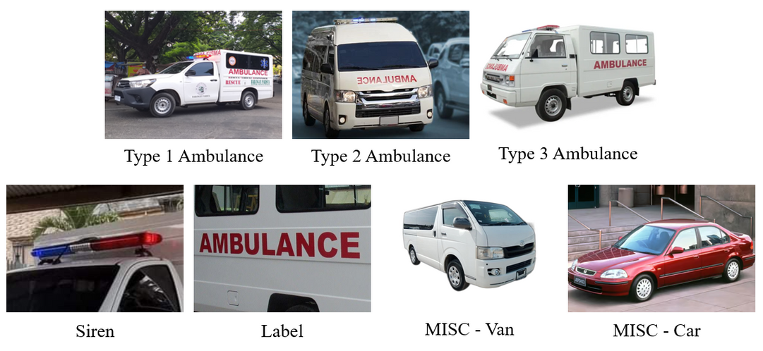
Introduction
Dataset Overview
Objectives
Dataset includes 1,840 images of ambulances, cars, and vans, all of which have sirens and are labeled "Ambulance."
This dataset is designed specifically for the YOLOv5s model, which is finely tuned for accurate ambulance detection and classification in the context of the Philippines.
Conceptual Framework
Methodology
Results and Discussion
Conclusion and Recommendations
References
A Computer Vision Approach to Ambulance Classification in the Philippines using YOLOv5 Small
Notes:
The dataset includes a total of 1,840 images, featuring ambulances, cars, and vans. The figure displays each of the different classes found within the dataset. Each ambulance within the dataset is equipped with sirens and labeled as "Ambulance." To improve the model's generalization, an equal distribution of 368 images is maintained for each vehicle type. This localized dataset is specifically curated for use with the YOLOv5s model, which is customized for accurate ambulance detection and classification in the Philippines. This tailored approach allows the model to differentiate ambulances from visually similar vehicles, reducing the occurrence of false positives.

Slide 13
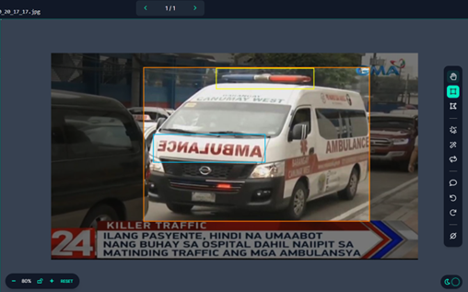
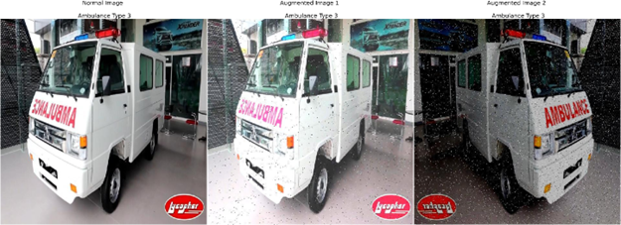
Introduction
Pre-processing and Data Augmentation
Objectives
Dataset cleaning phase to remove unsuitable images (blurry, out of frame, obstructed).
Data labeling on the Roboflow platform, manually labeling features like chassis, sirens, and "AMBULANCE" labels.
Labeled images exported as text files for machine learning classifier.
Data augmentation techniques applied to enhance YOLOv5 model's performance.
Data Augmentation Techniques used:
Outputs per Training Example (x3)
Horizontal Flipping
Hue Adjustment (-50° to +50°)
Saturation Modification (-50% to +50%)
Brightness Change (-40% to +40%)
Blur (Up to 4px)
Noise (Up to 10% of Pixels)
Conceptual Framework
Methodology
Results and Discussion
Conclusion and Recommendations
References
A Computer Vision Approach to Ambulance Classification in the Philippines using YOLOv5 Small
Notes:
The dataset undergoes initial cleaning to remove unsuitable images, such as blurry, out-of-frame, or obstructed ones. Researchers then use the Roboflow platform for data labeling, manually marking features like ambulance-like chassis, sirens, and "AMBULANCE" labels. Labeled images are exported as text files for machine learning classification.
To enhance the YOLOv5 model's performance, data augmentation is applied to artificially expand the dataset. Various techniques are employed for augmentation:
- Outputs per Training Example (x3): Creating multiple image variations during training for a more diverse dataset.
- Horizontal Flipping: Mirroring images along the vertical axis to ensure the model can recognize ambulances regardless of their orientation.
- Hue Adjustment (-50° to +50°): Simulating different lighting conditions by varying the hue.
- Saturation Modification (-50% to +50%): Adjusting saturation levels to add variability to color intensity.
- Brightness Change (-40% to +40%): Modifying brightness levels to prepare the model for different lighting intensities.
- Blur (Up to 4px): Introducing blur to mimic motion or out-of-focus scenarios.
- Noise (Up to 10% of Pixels): Adding noise to enhance the model's adaptability to pixel-level noise, preparing it for real-world clutter and imperfections.

Slide 14
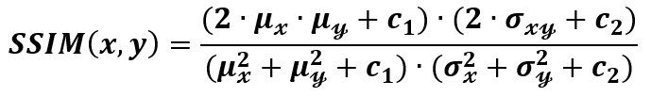
Introduction
Data Augmentation Image Testing (SSIM Scoring)
Objectives
Ensuring significant differences between augmented and original images is essential.
Structural Similarity Index (SSIM) testing is crucial for this purpose.
SSIM quantifies image similarity, with scores from 0 (no similarity) to 1 (perfect similarity).
SSIM accounts for various image statistics: means (μx, μy), standard deviations (σx, σy), and covariance (σxy) of pixel values.
It incorporates constants (c1 and c2) to prevent division by zero, set as small values for dataset robustness (e.g., c1 = (0.01⋅L)², c2 = (0.03⋅L)², with L as dynamic range).
Conceptual Framework
Methodology
Results and Discussion
Conclusion and Recommendations
References
A Computer Vision Approach to Ambulance Classification in the Philippines using YOLOv5 Small
Notes:
Augmentation techniques are pivotal for adding diversity to the dataset and improving the model's ability to handle various scenarios and variations. It's crucial, however, to ensure that the newly generated images differ significantly from the originals. To address this, the Structural Similarity Index (SSIM) test is invaluable.
SSIM serves as a robust metric for quantifying image similarity, offering scores between 0 and 1, with 1 indicating perfect similarity. This metric considers various image statistics, including means (μx, μy), standard deviations (σx, σy), and covariance (σxy) of pixel values. It also incorporates constants (c1 and c2) to prevent division by zero, set to small values to ensure robustness across diverse datasets, with L representing the dynamic range of pixel values)

Slide 15
Introduction
Model Training and Hyperparameter Tuning
Objectives
Dataset split: 70% training, 20% validation, 10% test.
Validation set used for performance assessment.
Key metrics: mAP@50, precision, recall.
mAP@50 (mean Average Precision at IoU of 0.5) evaluates object detection's ability to rank and retrieve objects with a 50% overlap with ground truth.
Precision measures accurate ambulance detection with few false positives.
Recall assesses the model's ability to detect all ambulances.
Hyperparameter tuning performed training on batch sizes 8, 16, and 32.
Conceptual Framework
Methodology
Results and Discussion
Conclusion and Recommendations
References
A Computer Vision Approach to Ambulance Classification in the Philippines using YOLOv5 Small
Notes:
Following dataset cleaning and augmentation, the dataset was divided into training, validation, and testing sets using the standard 70-20-10 ratio. For real-time vehicle detection, the YOLOv5 small model was chosen, as it strikes a balance between accuracy and speed while maintaining a compact size. YOLOv5 small excels in terms of performance, size, and latency, making it the most suitable choice among its variations for vehicle detection tasks.
The YOLOv5s model training process is systematic and comprehensive, leveraging advanced neural network architecture and optimization techniques [2]. To fine-tune the model's performance, hyperparameters were adopted from a prior study, with an epoch count of 150, three different batch sizes (8, 16, and 32), and a learning rate of 0.001. This approach is built upon prior research that performed hyperparameter tuning [1].

Slide 16
Introduction
Model Testing
Objectives
The model with the highest validation scores is selected for testing.
Evaluation on a dedicated test set assesses robustness and real-world applicability.
Consistent validation metrics, including mAP@50, precision, and recall, used to test the model on the test split.
Conceptual Framework
Methodology
Results and Discussion
Conclusion and Recommendations
References
A Computer Vision Approach to Ambulance Classification in the Philippines using YOLOv5 Small
Notes:
The model demonstrating the best validation scores, indicative of strong performance and adaptability, is the one that gets selected. This chosen model undergoes evaluation on a dedicated test set to assess its resilience and practicality in real-world scenarios. This evaluation serves as a comprehensive test of the model's readiness for deployment and involves the use of consistent validation metrics, including mAP@50, precision, and recall, applied to the test split of the dataset.

Slide 17
Introduction
Results and Discussion
Objectives
Data Augmentation Dissimilarity SSIM Results:
The dataset was augmented to create 3 new images per original image.
SSIM score were calculated between original and augmented images to quantify dissimilarity.
The average SSIM score was 0.1574 which indicates a high level of fiddimilarity between original and augmented images.
Augmenting datasets is very crucial for a better model performance, and these results demonstrates the augmentation was done properly as this can help in better generalization and in preventing redundancy in the dataset.
With the high dissimilarity in the augmented images, this will enable a more robust training and better generalization to the new dataset.
Conceptual Framework
Methodology
Results and Discussion
Conclusion and Recommendations
References
A Computer Vision Approach to Ambulance Classification in the Philippines using YOLOv5 Small
Notes:
The key to effective data augmentation is generating novel, diverse images rather than redundant copies of the originals. To evaluate this, the augmented the dataset by creating 3 new images for each original image.
The computed Structural Similarity scores between the original and augmented images to quantify their dissimilarity. The average SSIM was 0.1574, indicating a high degree of dissimilarity between originals and augmented images.
This is crucial for robust model training and generalization. Highly similar images would lead to redundancy without expanding the diversity of the dataset. The low SSIM confirms the augmentation introduced significant new information.
By generating such dissimilar synthetic images, overfitting can be avoided and the model is exposed to more varied examples. This enables better performance on new test data.
The high dissimilarity aligns with best practices for augmentation. The results validate that the techniques used were successful in creating novel images, rather than redundant duplicates of the originals.

Slide 18
Introduction
Results and Discussion
Objectives
Hyperparameter Tuning Validation Results:
Find the most optimal parameters for YOLOv5s on this dataset.
Validation scores were compared after each run of training.
The YOLOv5s model is trained in batch size 8, 16, 32. Learning Rate of 0.001. Epoch of 150.
The batch size of 8 led to the best YOLOv5 performance on the ambulance dataset based on the validation results.
Hyperparameter tuning ensures that the models are properly configured for the dataset.
Conceptual Framework
Methodology
Results and Discussion
Batch Size | mAP@50 | Precision | Recall
8 | 0.928 | 0.926 | 0.898
16 | 0.927 | 0.923 | 0.897
32 | 0.925 | 0.926 | 0.896
Conclusion and Recommendations
References
A Computer Vision Approach to Ambulance Classification in the Philippines using YOLOv5 Small
Notes:
Properly configuring deep learning models is crucial for optimal performance. To identify the best parameters for YOLOv5s on this ambulance dataset, the researchers systematically evaluated combinations of key hyperparameters.
They trained YOLOv5s using batch sizes of 8, 16, and 32 with a consistent learning rate of 0.001 over 150 epochs. After each training run, validation scores were compared.
Out of all combinations, a batch size of 8 led to the best YOLOv5s performance on this dataset based on the validation metrics. This aligned with the primary goal of determining the optimal model configuration.

Slide 19
Introduction
Results and Discussion
Objectives
YOLOv5 Model Testing Results:
The model was trained on an ambulance dataset with the use of augmentation and YOLOv5s. Hyperparameter tuning was done by testing batch sizes 8, 16, and 32.
With the batch size of 8, YOLOv5s achieved the best validation scores. This parameter was the one found to be optimal for a comprehensive testing of the dataset.
Test results showed that YOLOv5s accurately detects a wide variety of objects. The mAP@50 score were very high, wiht Ambulance - Type 3 which achieved 0.989 and Misc Vehicle - Car at 0.991.
Precision score of Ambulance - Type 3 gained 0.983 and a Recall score of 0.998.
The “Label: class had the lowest precision and recall score of 0.832 and 0.736 which indicates a room for improvement in detecting in this class
Conceptual Framework
Methodology
Results and Discussion
Conclusion and Recommendations
References
A Computer Vision Approach to Ambulance Classification in the Philippines using YOLOv5 Small
Notes:
The optimized YOLOv5s model was evaluated on the test set after hyperparameter tuning.
Test results validated accurate detection across object classes. mAP scores were very high, with Ambulance - Type 3 at 0.989 and Misc Vehicle - Car at 0.991.
Precision and recall metrics were also strong overall, demonstrating precise detection. The Label class had lower scores, presenting an opportunity to improve performance.
High mAP, precision, and recall for most classes confirm YOLOv5s generalized well after tuning on this dataset. The test results align with the goal of optimizing object detection through rigorous training and hyperparameter optimization.

Slide 20
Introduction
Class | mAP@50 | Precision | Recall
All | 0.93 | 0.929 | 0.903
Ambulance – Type 1 | 0.974 | 0.961 | 0.987
Ambulance – Type 2 | 0.947 | 0.908 | 0.958
Ambulance – Type 3 | 0.989 | 0.983 | 0.98
Label | 0.823 | 0.832 | 0.736
Misc Vehicle - Car | 0.991 | 0.971 | 0.97
Misc Vehicle - Van | 0.941 | 0.974 | 0.905
Siren | 0.842 | 0.874 | 0.786
Objectives
Conceptual Framework
Methodology
Results and Discussion
Conclusion and Recommendations
References
A Computer Vision Approach to Ambulance Classification in the Philippines using YOLOv5 Small
Notes:
Going back to the questions we seek to answer with the objectives of this research, 1st Which method and machine learning algorithms best classified the basketball maneuvers as proper or improper?
Based on the results of our study from the graphs indicated.
The ERT classifier gained a higher accuracy score than the LSTM classifier
While the ERT classifier significantly outperformed the LSTM classifier, the results from the LSTM classifier still look promising
19

Slide 21
Introduction
Conclusion
Objectives
Achieved a robust 92.8% mAP with the YOLOv5 small model, fulfilling the primary objective of detecting and classifying Philippine ambulances.
Conceptual Framework
Methodology
Low SSIM (0.1574) confirmed the successful augmentation of the dataset for diversity between clean and augmented images.
Results and Discussion
Batch size of 8 was found to yield the best results in fine-tuning hyperparameters for optimal YOLOv5 model performance in object detection tasks.
Conclusion and Recommendations
References
A Computer Vision Approach to Ambulance Classification in the Philippines using YOLOv5 Small
Notes:
In this study, the researchers had several key objectives. First, they aimed to classify different types of ambulances - Type 1, Type 2, and Type 3 - using the YOLOv5 model, with a particular emphasis on its small weight configuration. The results were quite impressive, with validation and test scores of 92.8% and 93%, respectively, which clearly demonstrate the model's capability in detecting and categorizing Philippine ambulances. This accomplishment fulfills our first objective.
The second objective involved assessing the diversity introduced by data augmentation. This was measured using the Structural Similarity Index (SSIM), which returned a low score of 0.1574. This result indicates that augmentation was successful in making the dataset more diverse, which was part of the second objective.
Lastly, the third objective was to fine-tune the model's hyperparameters. Through this process, they found that a batch size of 8 produced the best results. This highlights the importance of fine-tuning for achieving optimal object detection using YOLOv5.

Slide 22
Introduction
Recommendation
Objectives
Further research is needed for strengthening and validating the findings on ambulance vehicle detection and classification. Advanced optimization techniques can enhance the YOLOv5 model's performance.
Exploring methods like fine-tuning, transfer learning, and advanced architectures can improve accuracy and efficiency in detecting and classifying Philippine ambulances.
Consider application in prioritizing ambulances at intersections to enhance emergency response systems in the Philippines.
Create a more uniform dataset by capturing images under various real-world conditions for a generalized model. Establish a system for continuous monitoring and updates to adapt to evolving traffic management scenarios.
Conceptual Framework
Methodology
Results and Discussion
Conclusion and Recommendations
References
A Computer Vision Approach to Ambulance Classification in the Philippines using YOLOv5 Small
Notes:
The researchers have obtained promising results in ambulance vehicle detection and classification. However, there is a need for further investigation to build upon and validate these findings. Advanced optimization techniques, including fine-tuning, transfer learning, or the utilization of more advanced architectures, hold the potential to enhance the accuracy and efficiency of the YOLOv5 model.
In addition to this, the study suggests exploring the application of these findings for ambulance prioritization at intersections to enhance emergency response systems. To achieve a more generalized model, it is essential to create a dataset with images captured under diverse conditions.
Furthermore, establishing a system for ongoing monitoring and updates is critical to ensure the model's effectiveness in the dynamic environment of Philippine traffic management.

Slide 23
Introduction
[1] R. Dey, B. K. Pandit, A. Ganguly, A. Chakraborty and A. Banerjee, "Deep Neural Network Based Multi-Object Detection for Real-time Aerial Surveillance," 2023 11th International Symposium on Electronic Systems Devices and Computing (ESDC), Sri City, India, 2023, pp. 1-6, doi: 10.1109/ESDC56251.2023.10149866.
[2] X. Song and W. Gu, "Multi-objective real-time vehicle detection method based on yolov5," 2021 International Symposium on Artificial Intelligence and its Application on Media (ISAIAM), Xi'an, China, 2021, pp. 142-145, doi: 10.1109/ISAIAM53259.2021.00037.
[3] R. Yagfarov, V. Ostankovich and S. Gafurov, "Augmentation-Based Object Detection for Winter Time Applications," 2019 3rd School on Dynamics of Complex Networks and their Application in Intellectual Robotics (DCNAIR), Innopolis, Russia, 2019, pp. 178-180, doi: 10.1109/DCNAIR.2019.8875557.
[4] R. Anil, M. Satyakumar, and Ameena Salim. 2019. Emergency vehicle signal pre-emption system for heterogeneous traffic condition : A case study in Trivandrum City. 2019 4th International Conference on Intelligent Transportation Engineering (ICITE) (2019). DOI:http://dx.doi.org/10.1109/icite.2019.8880151
[5]Weiqi Yu, Weichen Bai, Wenjing Luan, and Liang Qi. 2022. State-of-the-art review on Traffic Control Strategies for Emergency vehicles. IEEE Access 10 (2022), 109729–109742. DOI:http://dx.doi.org/10.1109/access.2022.3213798
[6] Muhammad Azhad Bin Zuraimi and Fadhlan Hafizhelmi Kamaru Zaman. 2021. Vehicle detection and tracking using Yolo and DeepSORT. 2021 IEEE 11th IEEE Symposium on Computer Applications & Industrial Electronics (ISCAIE) (2021). DOI:http://dx.doi.org/10.1109/iscaie51753.2021.9431784
[7] Xiaohui Guan and Xinxin Sun. 2022. Vehicle identification and traffic statistics system in traffic intersection. 2022 4th International Conference on Intelligent Control, Measurement and Signal Processing (ICMSP) (2022). DOI:http://dx.doi.org/10.1109/icmsp55950.2022.9858960
[8] Jiaxing Zhang, Wen Xiao, Benjamin Coifman, and Jon P. Mills. 2020. Vehicle Tracking and Speed Estimation from Roadside Lidar. IEEE Journal of Selected Topics in Applied Earth Observations and Remote Sensing 13 (2020), 5597–5608. DOI:http://dx.doi.org/10.1109/jstars.2020.3024921
[9]Yunzhen Wang, Hongbing Ma, and Liangliang Li. 2022. Road traffic vehicle detection method using lightweight yolov5 and attention mechanism. 2022 7th International Conference on Image, Vision and Computing (ICIVC) (2022). DOI:http://dx.doi.org/10.1109/icivc55077.2022.9886525
[10] Chengpeng Wang, Huanqin Wang, Fajun Yu, and Wangjin Xia. 2021. A high-precision fast smoky vehicle detection method based on improved Yolov5 Network. 2021 IEEE International Conference on Artificial Intelligence and Industrial Design (AIID) (2021). DOI:http://dx.doi.org/10.1109/aiid51893.2021.9456462
Objectives
Conceptual Framework
Methodology
Results and Discussion
Conclusion and Recommendations
References
A Computer Vision Approach to Ambulance Classification in the Philippines using YOLOv5 Small

Slide 24
Introduction
[11] Othman O. Khalifa, Muhammad H. Wajdi, Rashid A. Saeed, Aisha H. Hashim, Muhammed Z. Ahmed, and Elmustafa Sayed Ali. 2022. Vehicle detection for vision-based intelligent transportation systems using convolutional neural network algorithm. Journal of Advanced Transportation 2022 (2022), 1–11. DOI:http://dx.doi.org/10.1155/2022/9189600
[12] Zhuang Li, Xincheng Tian, Yan Liu, and Xiaorui Shi. 2022. Vehicle tracking method based on attention-yolov5 and optimized DeepSort models. 2022 IEEE 11th Data Driven Control and Learning Systems Conference (DDCLS) (2022). DOI:http://dx.doi.org/10.1109/ddcls55054.2022.9858395
[13] Fuheng Guo and Yi Xu. 2022. Vehicle Analysis System based on DeepSORT and yolov5. 2022 3rd International Conference on Computer Vision, Image and Deep Learning & International Conference on Computer Engineering and Applications (CVIDL & ICCEA) (2022). DOI:http://dx.doi.org/10.1109/cvidliccea56201.2022.9824363
[14] Jiandong Wang, Yahui Dong, Shuangrui Zhao, and Zhiwei Zhang. 2023. A high-precision vehicle detection and tracking method based on the attention mechanism. Sensors 23, 2 (2023), 724. DOI:http://dx.doi.org/10.3390/s23020724
[15] Liu Xiaomeng, Feng Jun, and Chen Peng. 2022. Vehicle detection in traffic monitoring scenes based on improved Yolov5s. 2022 International Conference on Computer Engineering and Artificial Intelligence (ICCEAI) (2022). DOI:http://dx.doi.org/10.1109/icceai55464.2022.00103
[16] Baoping Xiao, Jinghua Guo, and Zhifei He. 2021. Real-time object detection algorithm of autonomous vehicles based on improved Yolov5s. 2021 5th CAA International Conference on Vehicular Control and Intelligence (CVCI) (2021). DOI:http://dx.doi.org/10.1109/cvci54083.2021.9661149
[17] Xuyang Song and Wei Gu. 2021. Multi-objective real-time vehicle detection method based on Yolov5. 2021 International Symposium on Artificial Intelligence and its Application on Media (ISAIAM) (2021). DOI:http://dx.doi.org/10.1109/isaiam53259.2021.00037
[18] Lei Shao, Zhenqiang Fan, Ji Li, and Hongli Liu. 2022. Research on road vehicle detection based on improved Yolov5s. 2022 IEEE International Conference on Mechatronics and Automation (ICMA) (2022). DOI:http://dx.doi.org/10.1109/icma54519.2022.9856288
[19] Erika Ritzelle Bondoc, Francis Percival Caparas, John Eddie Macias, Vileser T. Naculangga, and Jheanel E. Estrada. 2018. An intelligent road traffic information system using text analysis in the most congested roads in Metro Manila. 2018 IEEE 10th International Conference on Humanoid, Nanotechnology, Information Technology,Communication and Control, Environment and Management (HNICEM) (2018). DOI:http://dx.doi.org/10.1109/hnicem.2018.8666416
[20] L. -S. Tseng, C. -H. Wu, Y. H. Chen and C. -H. Tsai, GAN-based Data Augmentation for Metal Surface Defect Detection Using Convolutional Neural Networks. (2023). Ieeexplore.ieee.org. Retrieved October 12, 2023, from https://ieeexplore.ieee.org/document/10219520
Objectives
Conceptual Framework
Methodology
Results and Discussion
Conclusion and Recommendations
References
A Computer Vision Approach to Ambulance Classification in the Philippines using YOLOv5 Small

Slide 25

Thank you for listening!
Steve Vincent Phillip C. Feria
svpcferia@mymail.mapua.edu.ph
Jose Rafael A. Franco
jrafranco@mymail.mapua.edu.ph
Hans C. Laguna
hclaguna@mymail.mapua.edu.ph

